Slide 1

Building Clustered Applications in a Distributed Architecture
David Sietz
Data Architect
Reference Material
https://github.com/dsietz/datadot

Slide 2
1
overview
2
multicasting
3
hook & dynamic plugins
4
demo

Slide 3
1
overview
2
multicasting
3
hook & dynamic plugins
4
demo

Slide 4





Overview
Trends that we have witnessed …
Business
Technology
High Availability
cloud computing
Scalability
containerization
Time To Market
Data Driven Decisions
microservices
Customer Centric Products
mapreduce
brokering

Slide 5
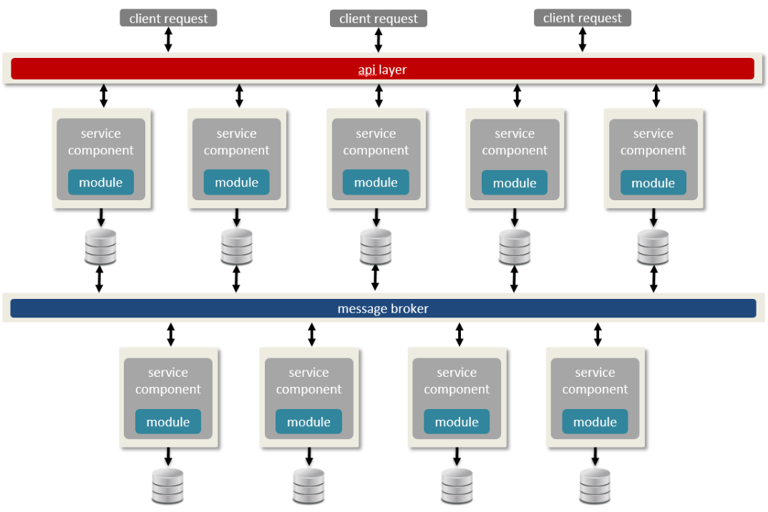
Overview
High Availability
Data Driven Decisions
Time To Market
Scalability
Customer Centric Products
Layer 1
Layer 2
Layer 3
Layer 3
Layer 2
Layer 3
Distributed Architecture
cloud computing
containerization
mapreduce
brokering
microservices

Slide 6






Clustering
Clustering databases paved the way toward distributed systems.

Slide 7
Clustering
High Performance | High Availability | Load Balancing
computation-intensive applications | failover to redundant node | shared workload between nodes
predictive modeling simulators “supercomputing” | business applications databases file shares | web server Proxy server

Slide 8
Clustering
failover
management
master
load balancing
controller
Unicasting
point-to-point communication
master: 10.100.15.23
worker A: 10.100.15.24
worker B: 10.100.15.25
worker A: 10.100.15.24
worker B: 10.100.15.25
Specialized Nodes
single point of failure
worker A
worker B
computation
computation
master: 10.100.15.23
worker B: 10.100.15.25
master: 10.100.15.23
worker A: 10.100.15.24

Slide 9
Clustering
High Performance | High Availability | Load Balancing
computation-intensive applications | failover to redundant node | shared workload between nodes
predictive modeling simulators “supercomputing” | business applications databases file shares | web server Proxy server

Slide 10
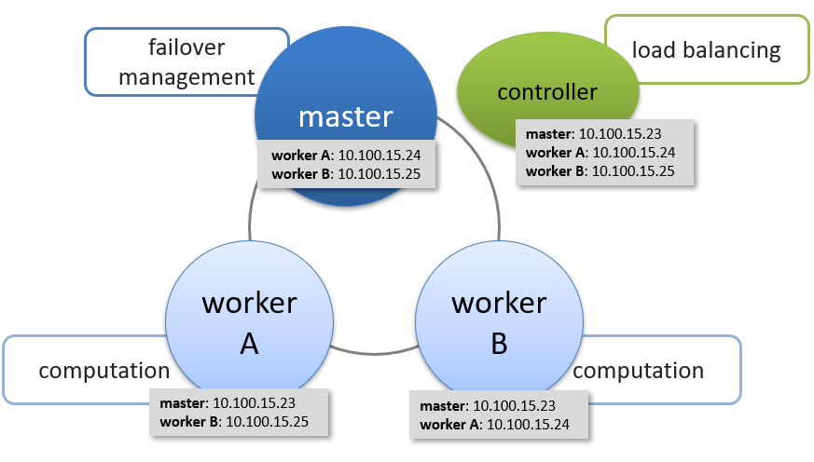
What If?
Business
High Availability
Scalability
Time To Market
Data Driven Decisions
Customer Centric Products
High Performance

Slide 11
High Performance Solutions
System Changes: Increase CPU, Memory, or Network bandwidth
Scale Horizontally: Add more nodes to the cluster
Data Retrieval: Add caching, indexing, or provision of data
Network Latency: Geographically relocate data and services
Communication: multicasting

Slide 12
Notes
Clustering for High Performance
Point to point causes clustering performance issues – multicasting
Use cases for multicasting – video, financial industry
Pitfalls of multicasting

Slide 13
1
overview
2
multicasting
3
hook & dynamic plugins
4
demo

Slide 14
Unicasting
worker
controller
worker
worker
master

Slide 15
Unicasting
worker
controller
worker
worker
master

Slide 16
Unicasting
worker
controller
worker
worker
master

Slide 17
Unicasting
PROs | CONs
know who’s listening guarantee delivery | must know communication socket (IP address and port) Chatty not intended for group communication

Slide 18
1
overview
2
multicasting
3
hook & dynamic plugins
4
demo

Slide 19
1
overview
2
multicasting
3
hook & dynamic plugins
4
demo

Slide 20
1
overview
2
multicasting
3
hook & dynamic plugins
4
demo

